Slide 1
Virtual LANs

Slide 2
VLAN introduction
VLANs logically segment switched networks based on the functions, project teams, or applications of the organization regardless of the physical location or connections to the network.
All workstations and servers used by a particular workgroup share the same VLAN, regardless of the physical connection or location.

Slide 3
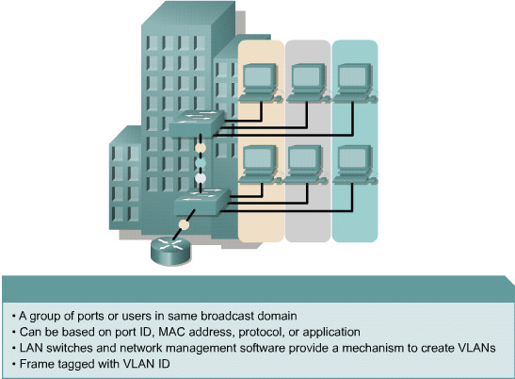
VLAN introduction
A workstation in a VLAN group is restricted to communicating with file servers in the same VLAN group.

Slide 4
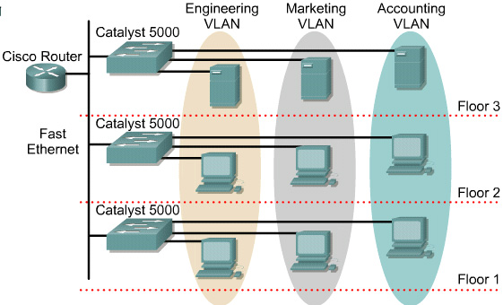
VLAN introduction
VLANs function by logically segmenting the network into different broadcast domains so that packets are only switched between ports that are designated for the same VLAN.
Routers in VLAN topologies provide broadcast filtering, security, and traffic flow management.

Slide 5
VLAN introduction
VLANs address scalability, security, and network management.
Switches may not bridge any traffic between VLANs, as this would violate the integrity of the VLAN broadcast domain.
Traffic should only be routed between VLANs.

Slide 6
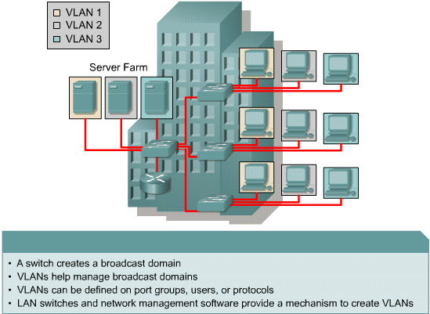
Broadcast domains with VLANs and routers
A VLAN is a broadcast domain created by one or more switches.

Slide 7
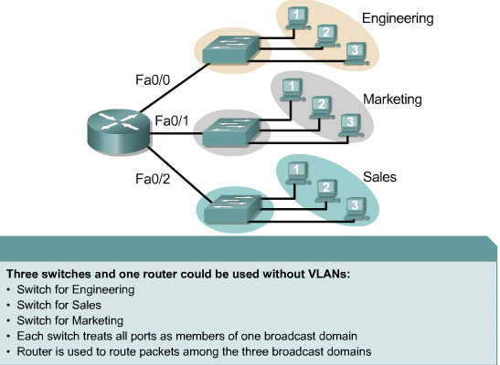
Broadcast domains with VLANs and routers
Layer 3 routing allows the router to send packets to the three different broadcast domains.

Slide 8
Broadcast domains with VLANs and routers
Implementing VLANs on a switch causes the following to occur:
  The switch maintains a separate bridging table for each VLAN.
  If the frame comes in on a port in VLAN 1, the switch searches the bridging table for VLAN 1.
  When the frame is received, the switch adds the source address to the bridging table if it is currently unknown.
  The destination is checked so a forwarding decision can be made.
  For learning and forwarding the search is made against the address table for that VLAN only.

Slide 9
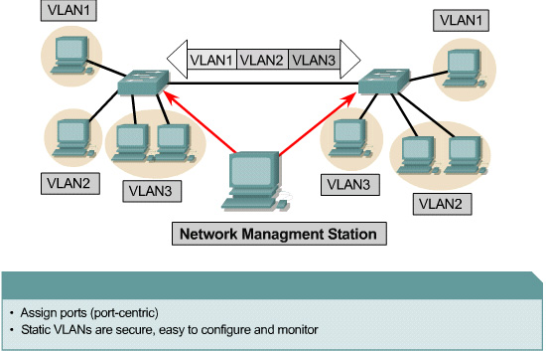
VLAN operation
Each switch port could be assigned to a different VLAN.
Ports assigned to the same VLAN share broadcasts.
Ports that do not belong to that VLAN do not share these broadcasts.

Slide 10
VLAN operation
Users attached to the same shared segment, share the bandwidth of that segment.
Each additional user attached to the shared medium means less bandwidth and deterioration of network performance.
VLANs offer more bandwidth to users than a shared network.
The default VLAN for every port in the switch is the management VLAN.
The management VLAN is always VLAN 1 and may not be deleted. All other ports on the switch may be reassigned to alternate VLANs.

Slide 11
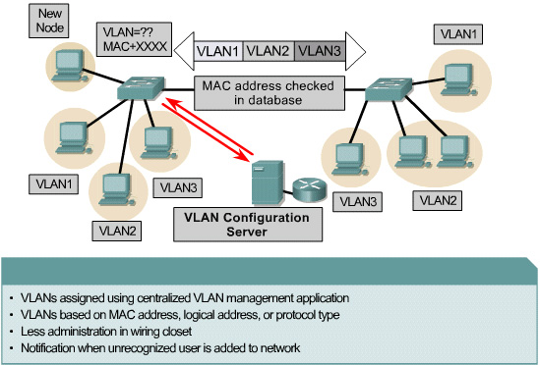
VLAN operation
Dynamic VLANs allow for membership based on the MAC address of the device connected to the switch port.
As a device enters the network, it queries a database within the switch for a VLAN membership.

Slide 12
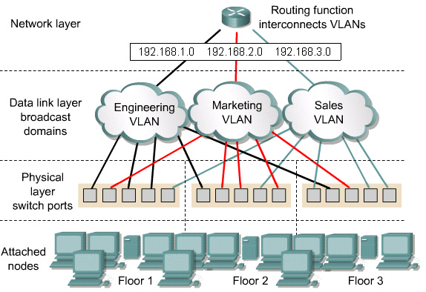
VLAN operation
In port-based or port-centric VLAN membership, the port is assigned to a specific VLAN membership independent of the user or system attached to the port.
All users of the same port must be in the same VLAN.

Slide 13
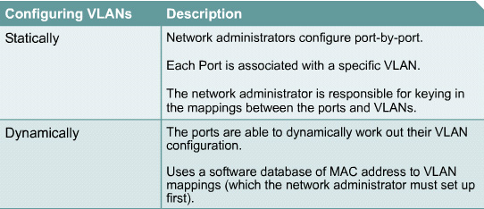
VLAN operation
Network administrators are responsible for configuring VLANs both manually and statically.

Slide 14
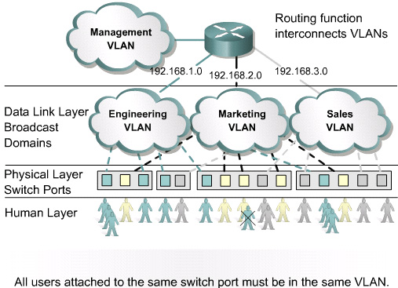
Benefits of VLANs
The key benefit of VLANs is that they permit the network administrator to organize the LAN logically instead of physically.

Slide 15
VLAN types
There are three basic VLAN memberships for determining and controlling how a packet gets assigned: -
  Port-based VLANs
  MAC address based
  Protocol based VLANs
The frame headers are encapsulated or modified to reflect a VLAN ID before the frame is sent over the link between switches.
Before forwarding to the destination device, the frame header is changed back to the original format.

Slide 16
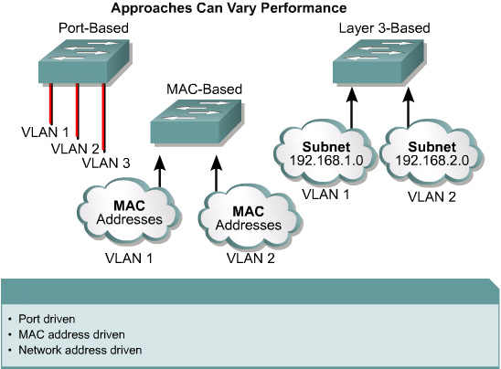
VLAN types
Port-based VLANs
MAC address based VLANs
Protocol based VLANs

Slide 17
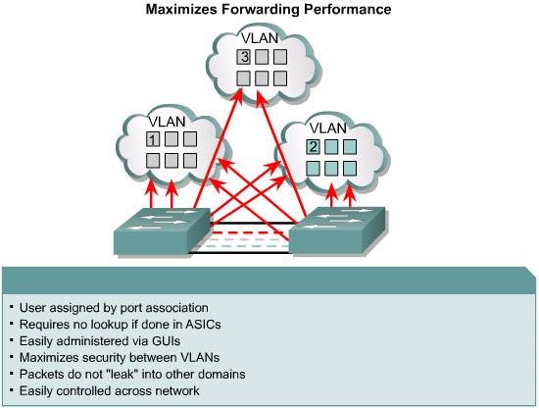
Membership by Port

Slide 18
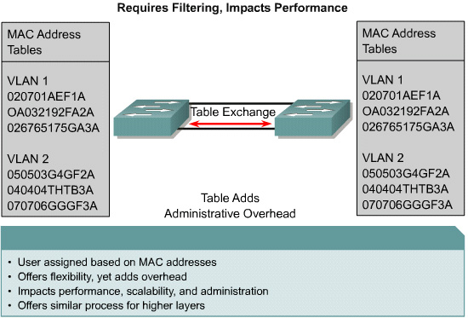
Membership by MAC-Addresses

Slide 19
VLAN types
The number of VLANs in a switch vary depending on several factors:
  Traffic patterns
  Types of applications
  Network management needs
  Group commonality

Slide 20
VLAN types
An important consideration in defining the size of the switch and the number of VLANs is the IP addressing scheme.
Because a one-to-one correspondence between VLANs and IP subnets is strongly recommended, there can be no more than 254 devices in any one VLAN.
It is further recommended that VLANs should not extend outside of the Layer 2 domain of the distribution switch.

Slide 21
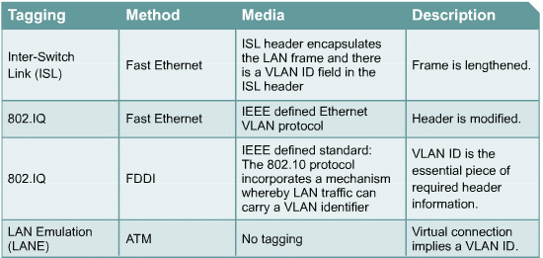
VLAN types
There are two major methods of frame tagging, Inter-Switch Link (ISL) and 802.1Q.
ISL used to be the most common, but is now being replaced by 802.1Q frame tagging.

